Slide 1
PHY 256: Introduction To Quantum Physics Summer 2020
Barak Shoshany
Department of Physics, University of Toronto
barak.shoshany@utoronto.ca
http://baraksh.com/

Slide 2
Course Logistics
Website: baraksh.com/PHY256
Lectures on Zoom every Mon & Wed 1pm-3pm until June 15th
Tutorials after the lectures
Victoria Day Vacation May 18th
Lectures and tutorials recorded and posted on Quercus
It’s important to attend the live meetings
Lectures posted on YouTube but with student interactions edited out
To ask a question:
Unmute yourself and speak, or
Send a chat message

Slide 3
Lecturer and teaching assistants
Lecturer: Barak Shoshany
PhD, Perimeter Institute
Research: general relativity, quantum gravity, scientific computing
Office hours: Tue 11am-1pm on Zoom (starting next week)
Email: barak.shoshany@utoronto.ca
We can schedule 1-on-1 video chats
TAs:
Aaron Goldberg, goldberg@physics.utoronto.ca
Jyotirmoy Roy, jro1@physics.utoronto.ca

Slide 4
Lecture notes and overview
Lecture notes on the website: baraksh.com/PHY256
No textbooks
Concept:
Not a traditional quantum mechanics course
Quantum theory from 21st century point of view
Axiomatic, mathematically rigorous(ish), develop from scratch
Emphasis on deep conceptual understanding, not calculations
Goals:
Develop intuition for quantum physics
Be prepared for more advanced courses and research

Slide 5
Syllabus 1/2
Failures of classical mechanics, quantum vs. classical
Mathematical background
Complex numbers, linear algebra, probability
Axiomatical definition of quantum theory
Hilbert spaces, states, operators, observables, superposition, probability amplitudes, expectation values…

Slide 6
Syllabus 2/2
Discrete systems (qubits)
Schrödinger’s cat, quantum entanglement, Bell's inequality, the uncertainty principle, unitary evolution, quantum measurements, quantum teleportation…
Continuous systems (particles)
Hamiltonians, the Schrödinger equation, the quantum harmonic oscillator, wavefunctions, the wave-particle duality, quantum interference, scattering and tunneling in one dimension…
Advanced topics, if time permits
Canonical quantization, path integrals, quantum algorithms, particle physics, quantum field theory, quantum gravity…

Slide 7
Homework, assessments, grading
6 weekly homework assignments
Pass or fail
Pass = 3% of final grade
Collaboration is allowed
Mid-term oral assessment
1-on-1 video chat with me, 10 minutes
Conceptual questions, maybe short calculations
22% of final grade
Final oral assessment
1-on-1 video chat with me, 15 minutes
60% of final grade

Slide 8
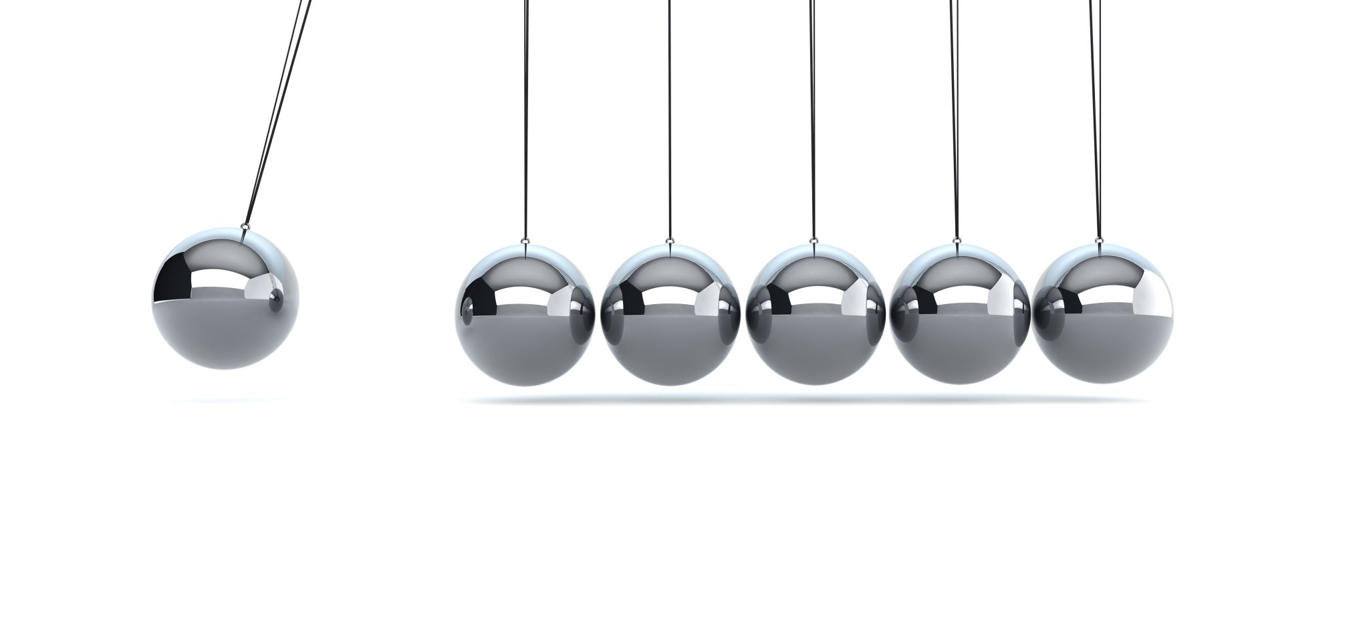
The Failures of Classical Physics

Slide 9
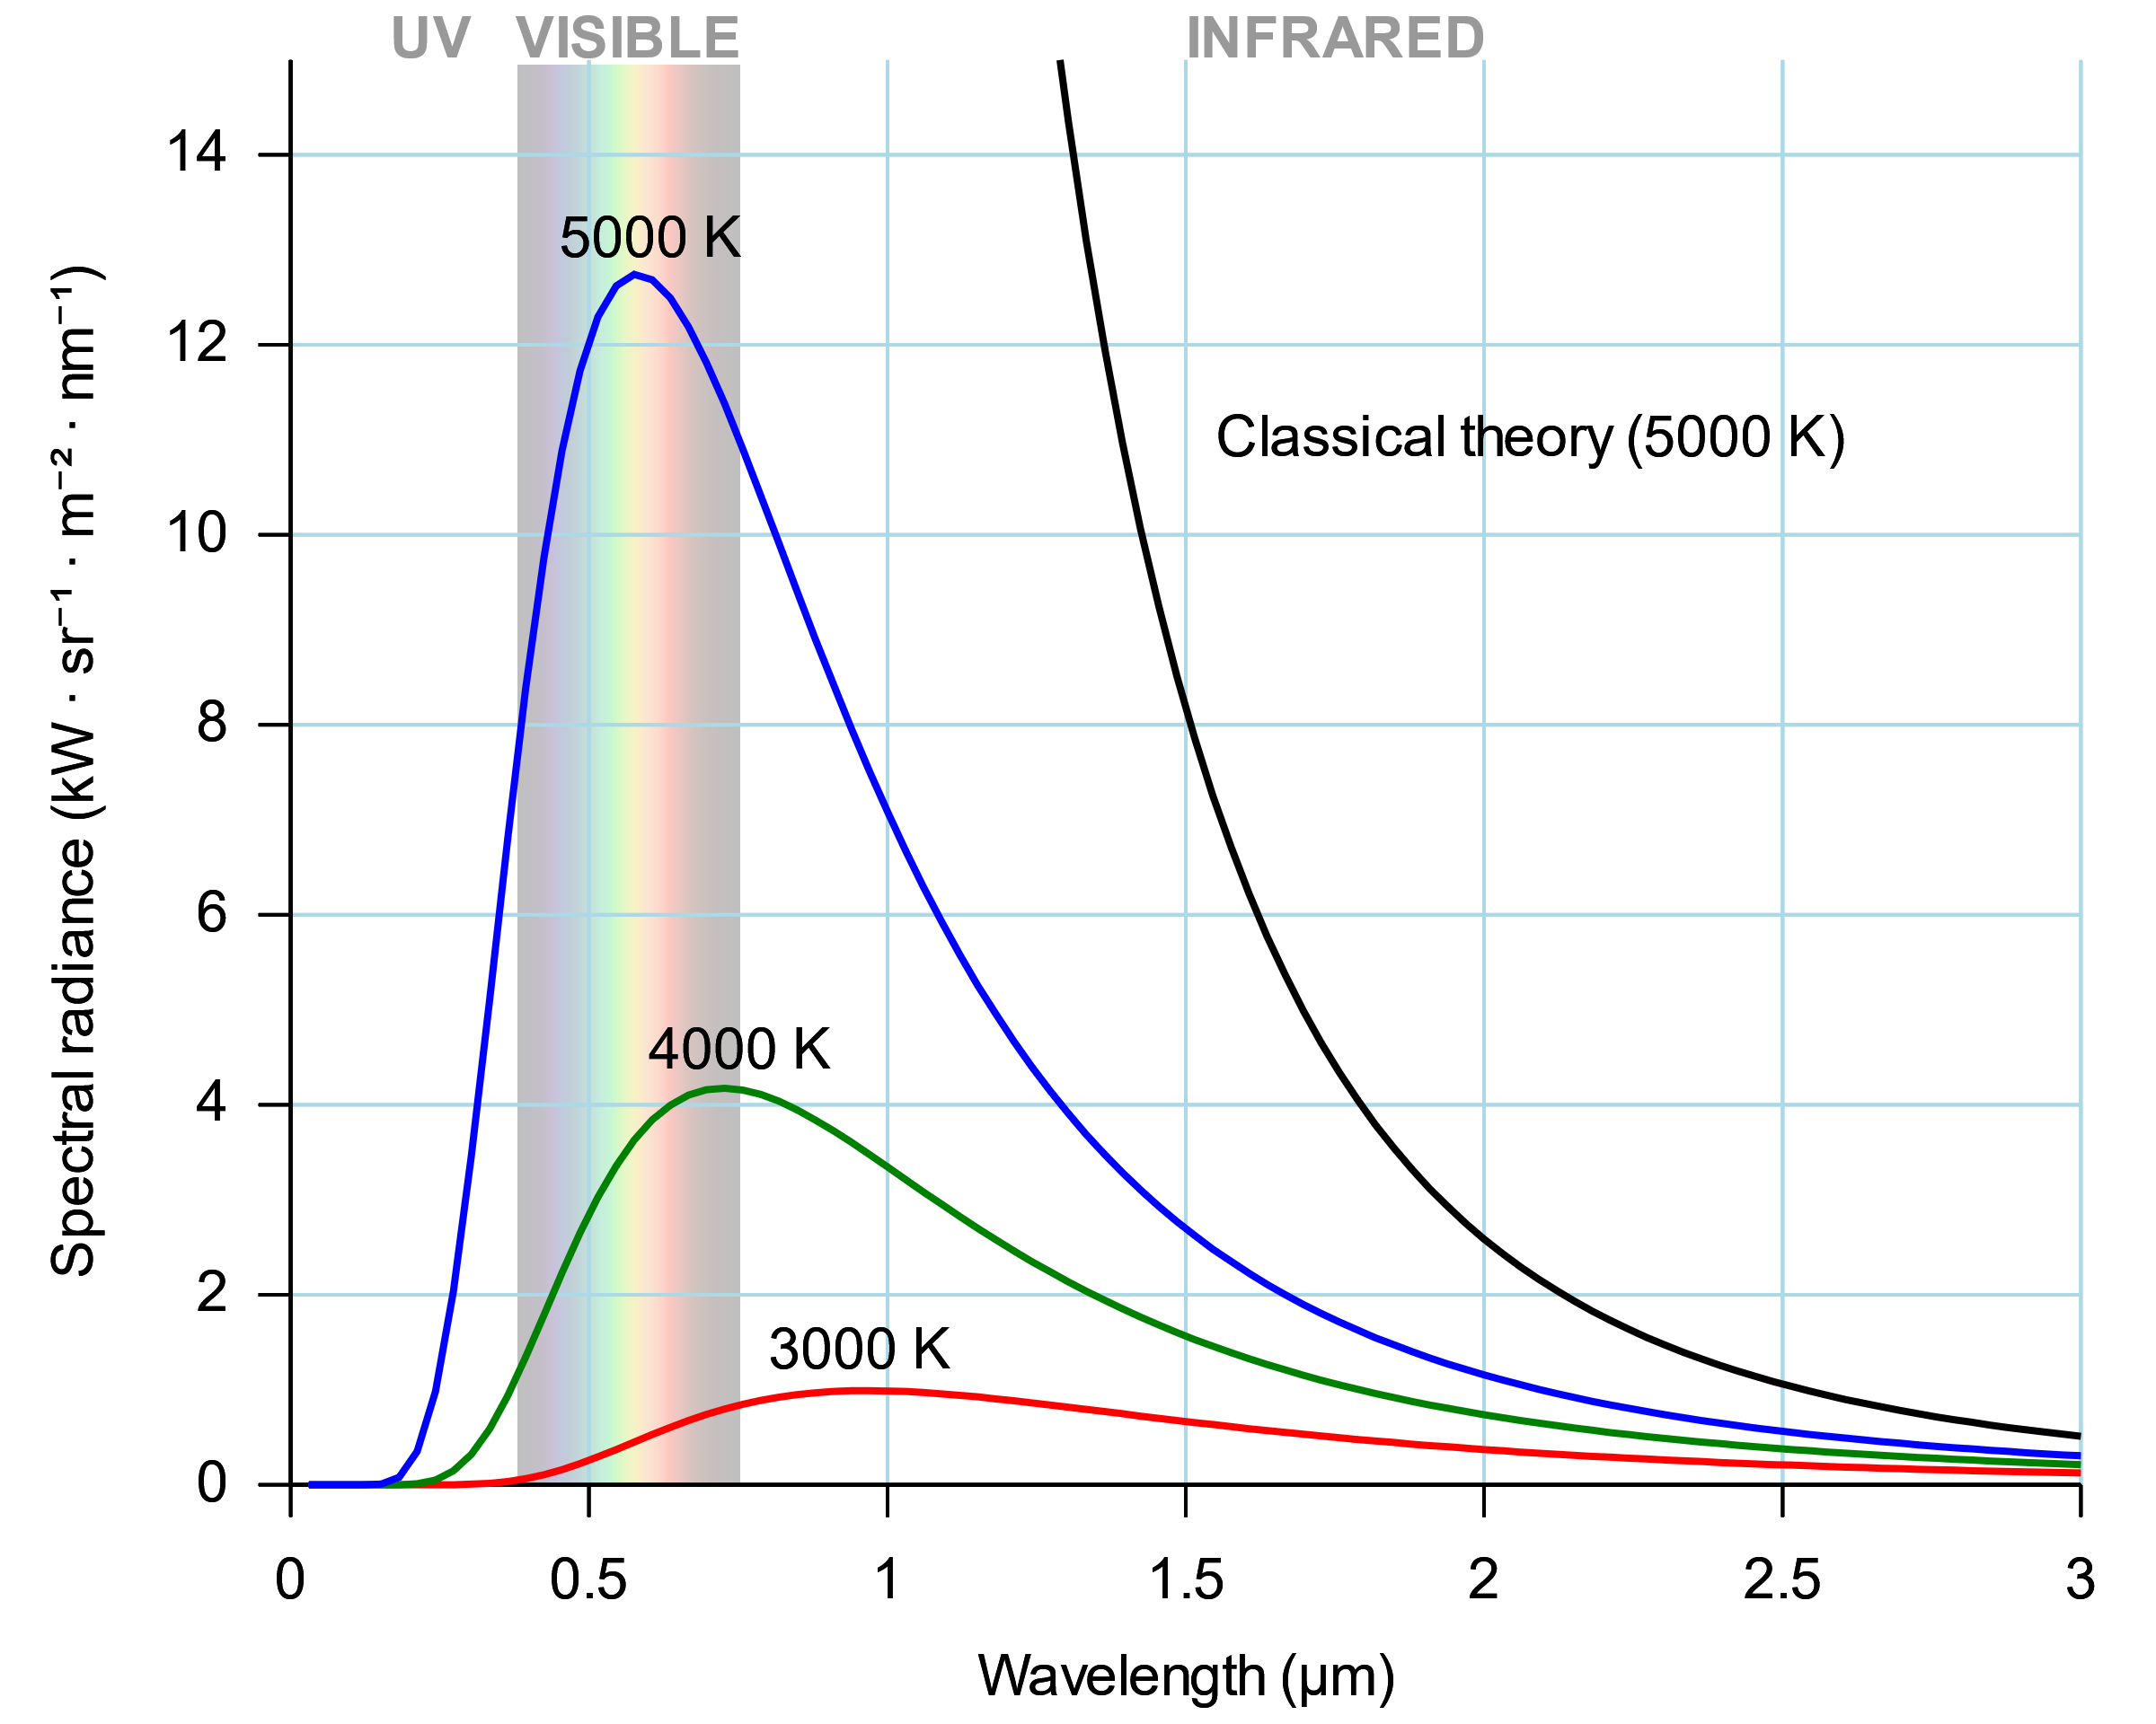
Black-Body Radiation and the Ultraviolet Catastrophe
Spectrum
Quanta
Planck’s law
Photons

Slide 10
The Photoelectric Effect
Prediction:
Speed ∝ brightness
Current ∝ frequency
Brightness threshold
Reality:
Speed ∝ frequency
Current ∝ brightness
Frequency threshold
Photons:
Energy ∝ frequency
No. of photons ∝ brightness

Slide 11
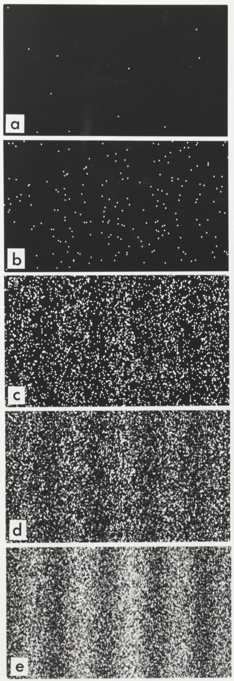
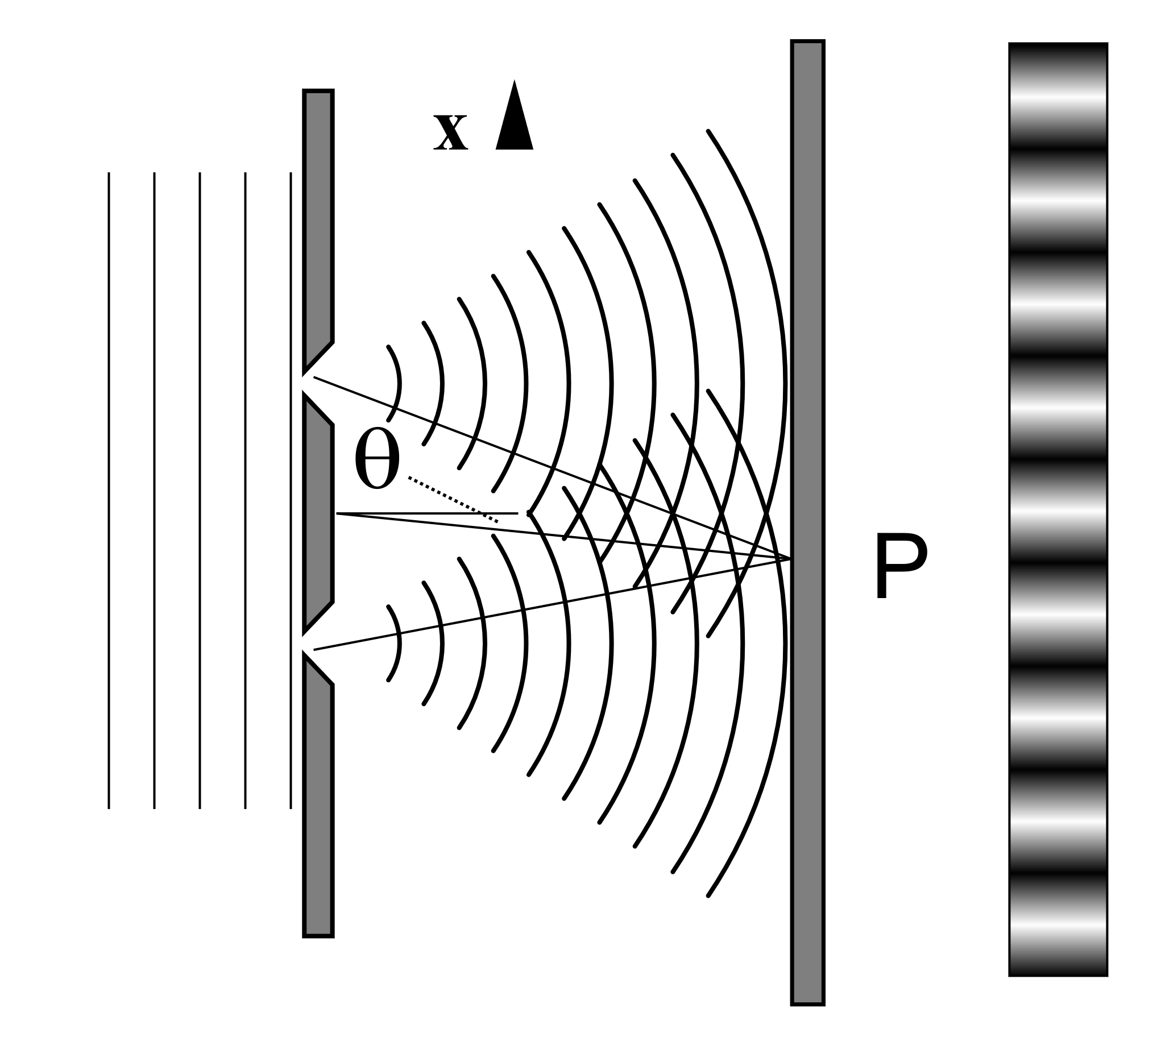
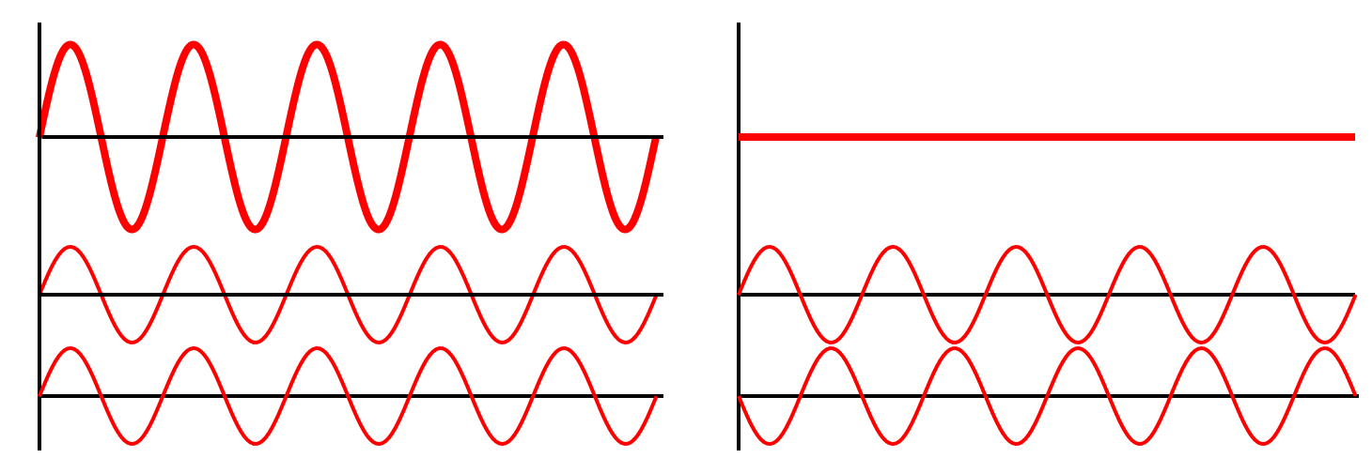
The Double-Slit Experiment
Crest, trough
Constructive interference
Destructive interference
Wave-particle duality
Quantum excitation
Quantum field theory

Slide 12
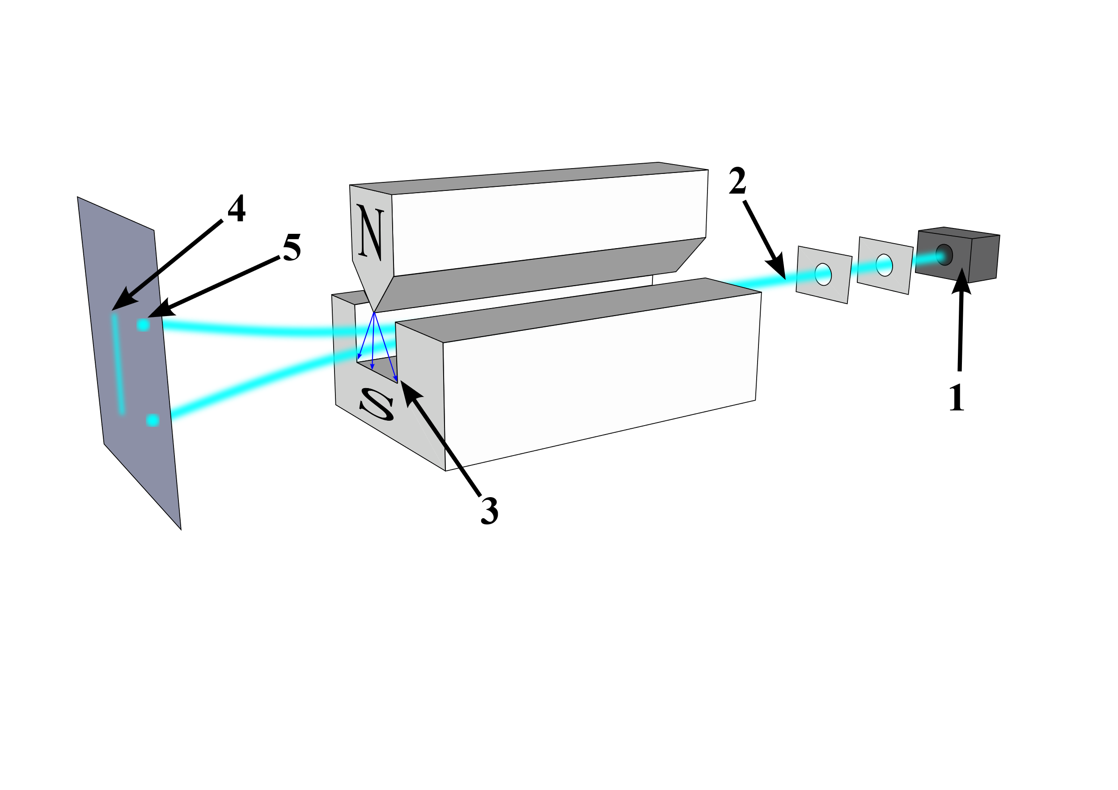
The Stern-Gerlach Experiment
Magnetic field
Angular momentum
Intrinsic spin
“Spin up”, “spin down”
Quantized
Qubits: quantum bits

Slide 13
Quantum vs. Classical Mechanics

Slide 14
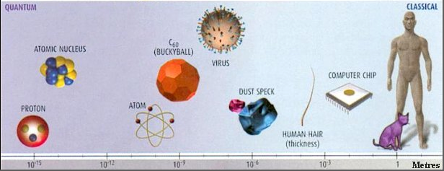
Quantum vs. Classical Mechanics
Quantum | Classical
Fundamental | Approximation
Small things | Big things
Discrete | Continuous

Slide 15
Quantum vs. Classical Mechanics
Quantum | Classical
Probability | Determinism
Superposition of states | One state
Uncertainty | Certainty

Slide 16
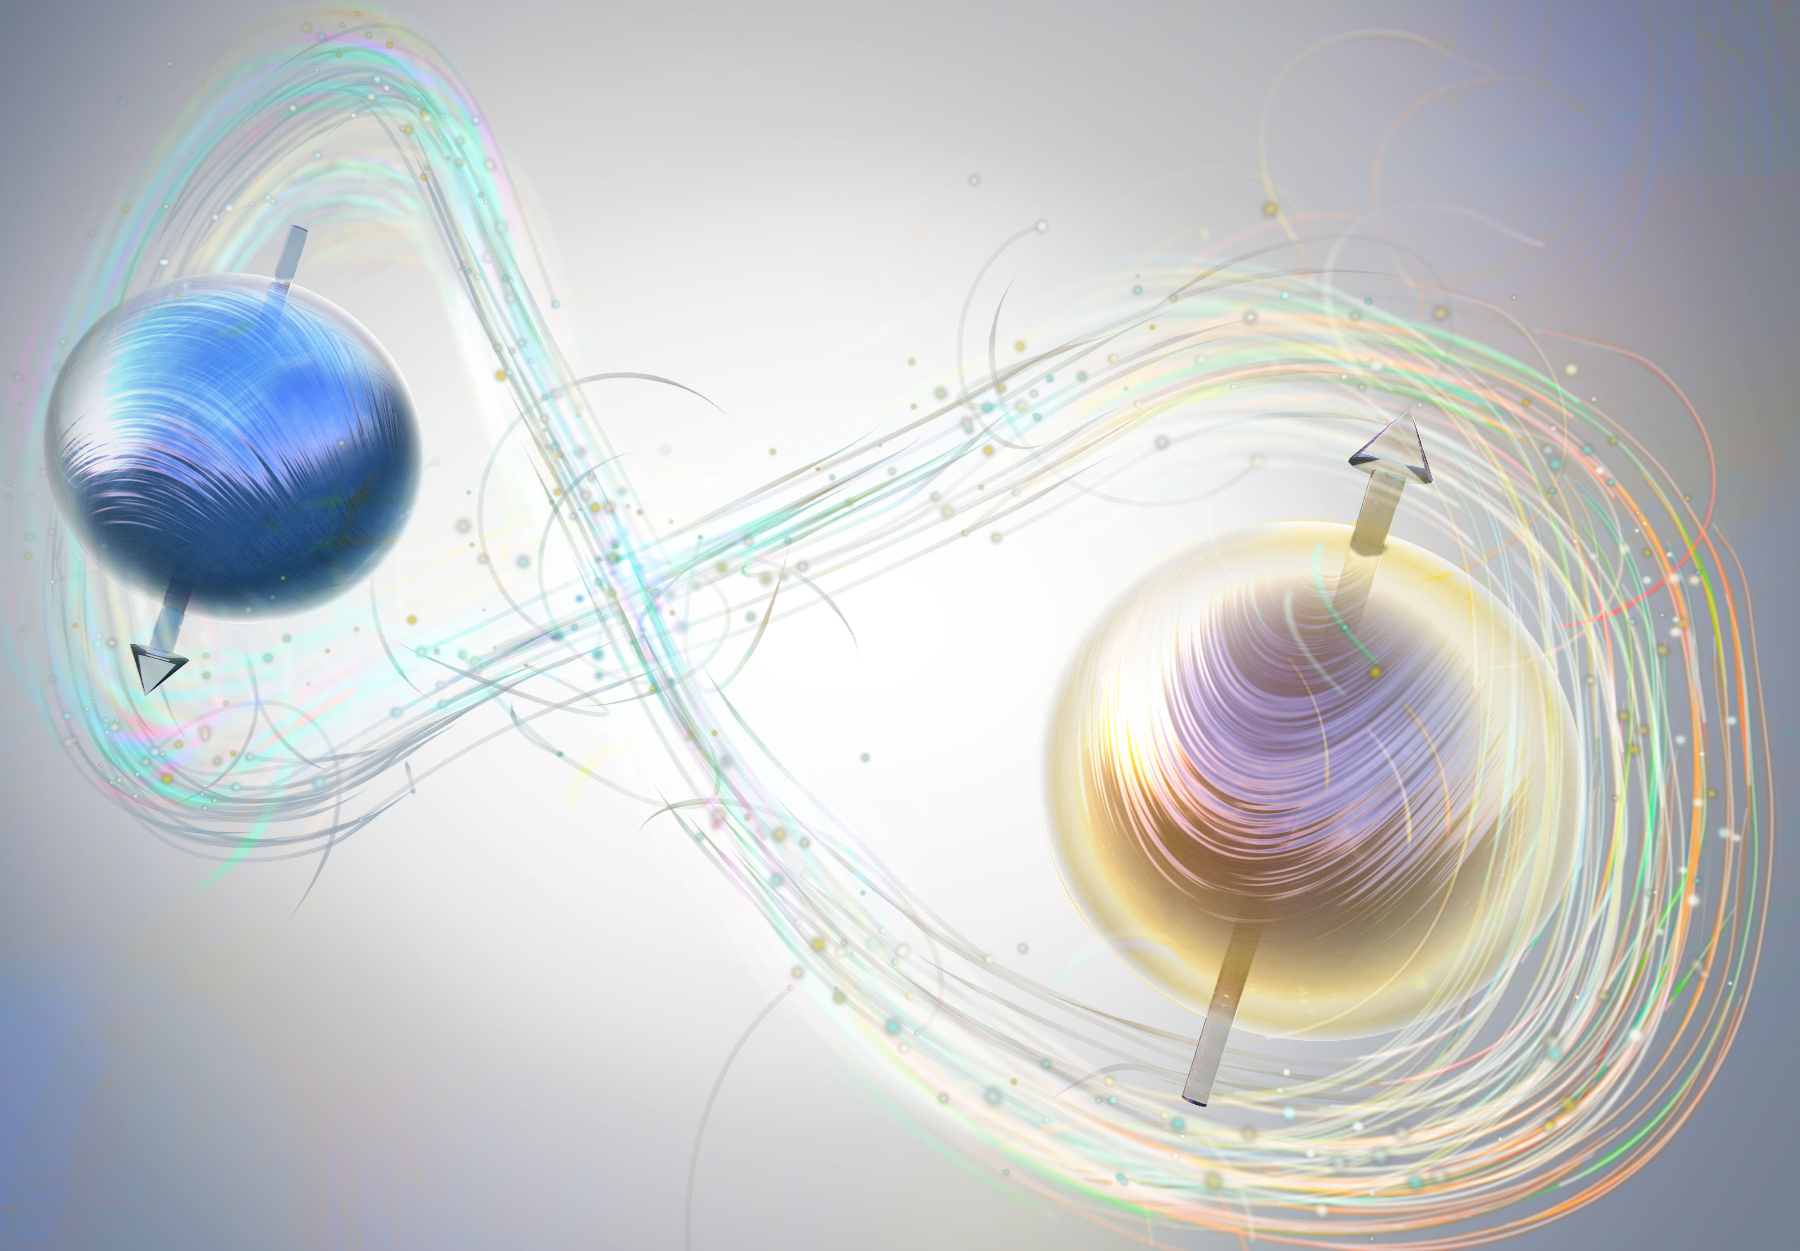
Quantum vs. Classical Mechanics
Quantum | Classical
Entanglement | Normal correlation

Slide 17
Any questions?

Slide 18
Next: Tutorials!

